Slide 1

Tactical Analysis of a Batsman
K. ANIKETH

Slide 2

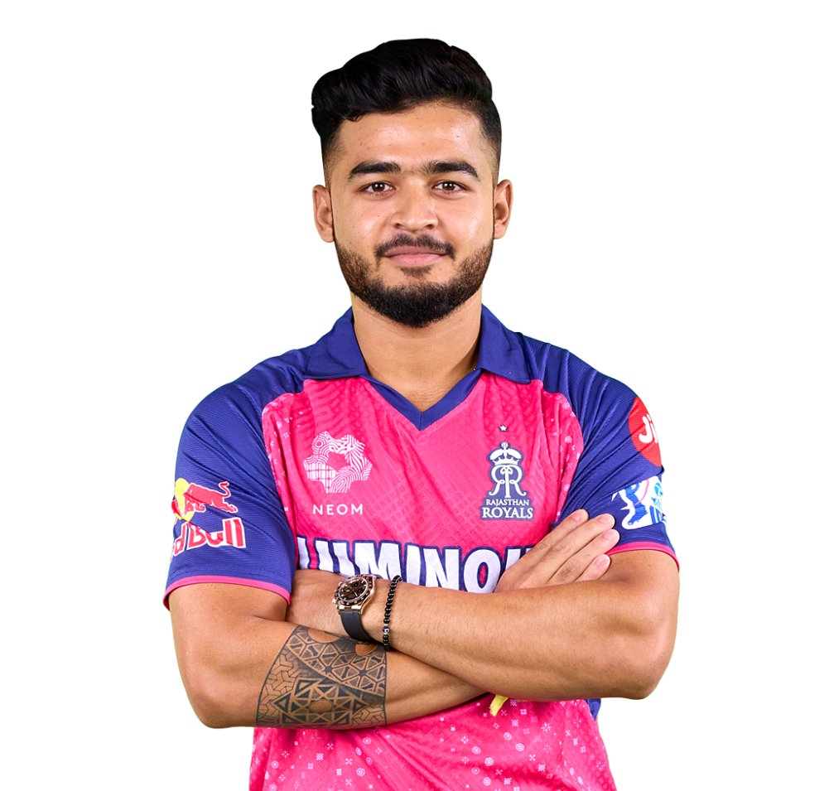
Riyan Parag
Parag 2.0 From Blunder to Wonder

Slide 3
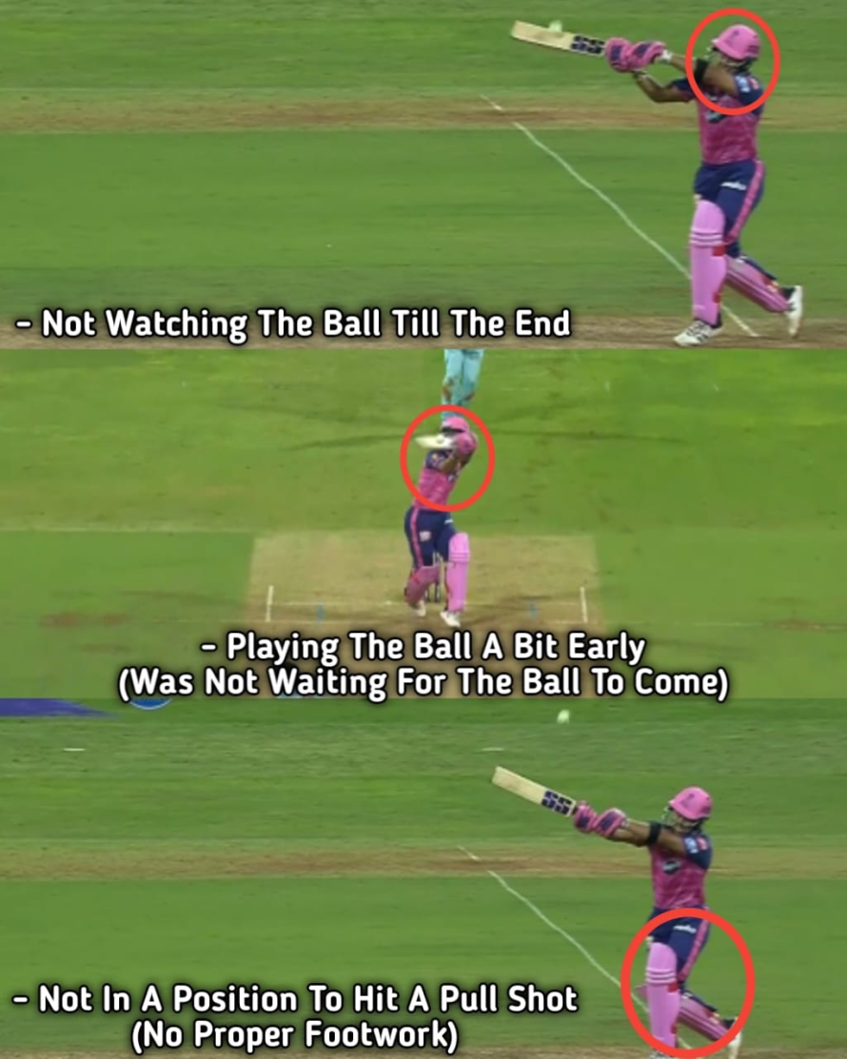
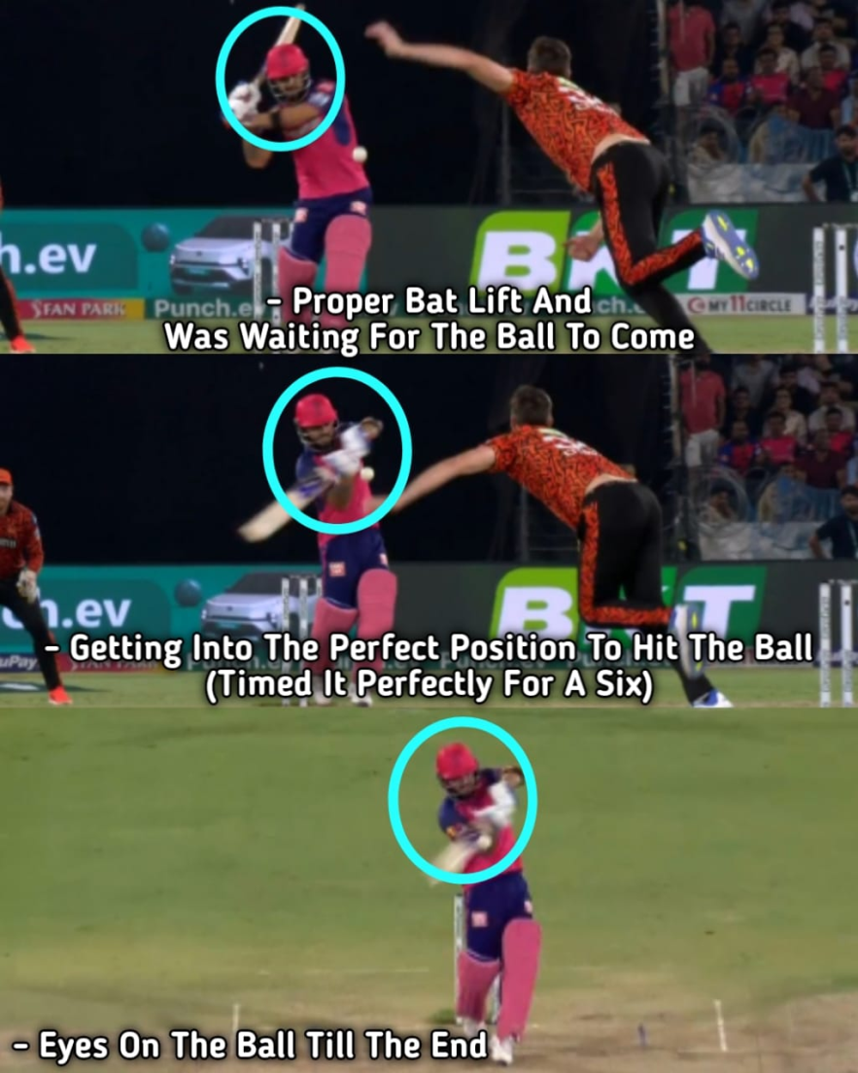
Previous season vs This season Parag vs Body Line Bouncer

Slide 4
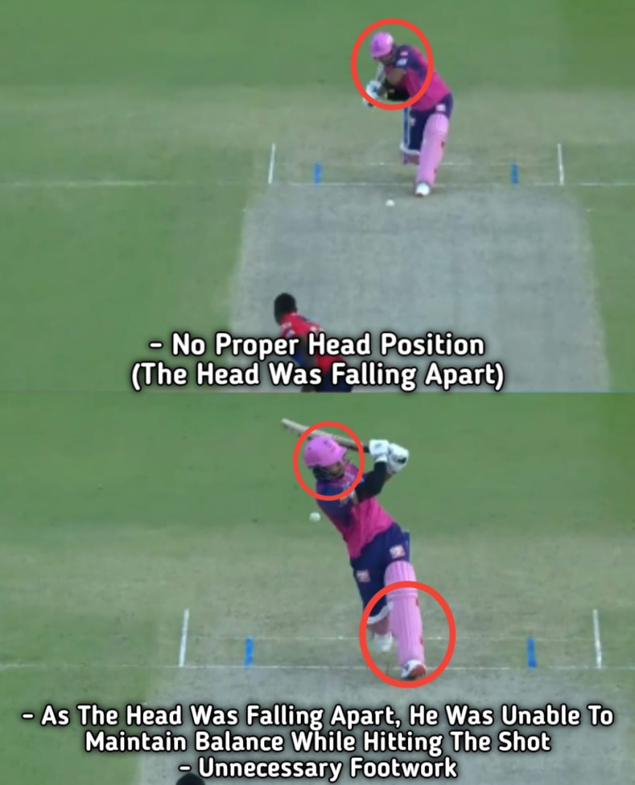
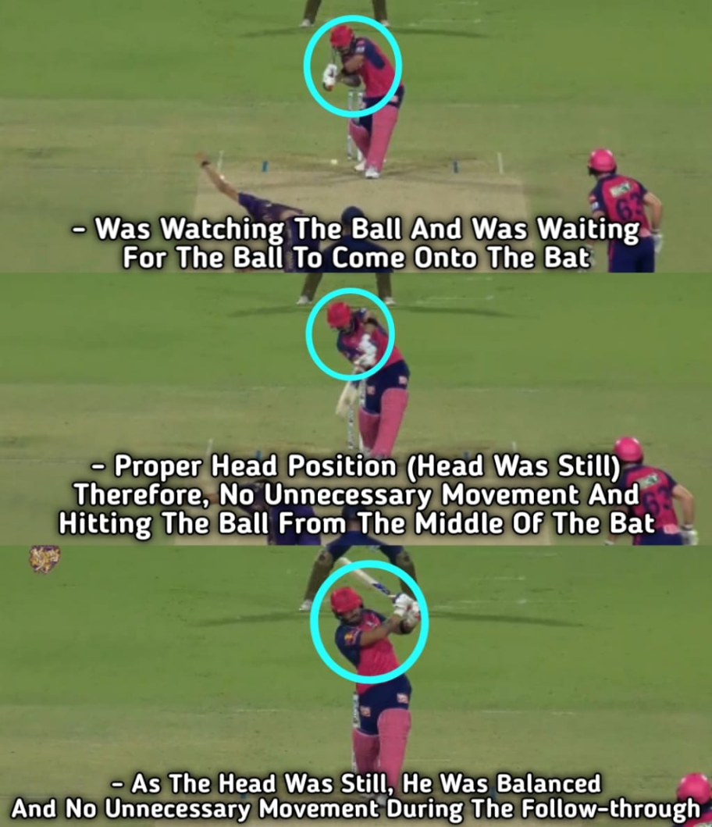
Previous season vs This season Parag vs Incoming Good Length Delivery

Slide 5
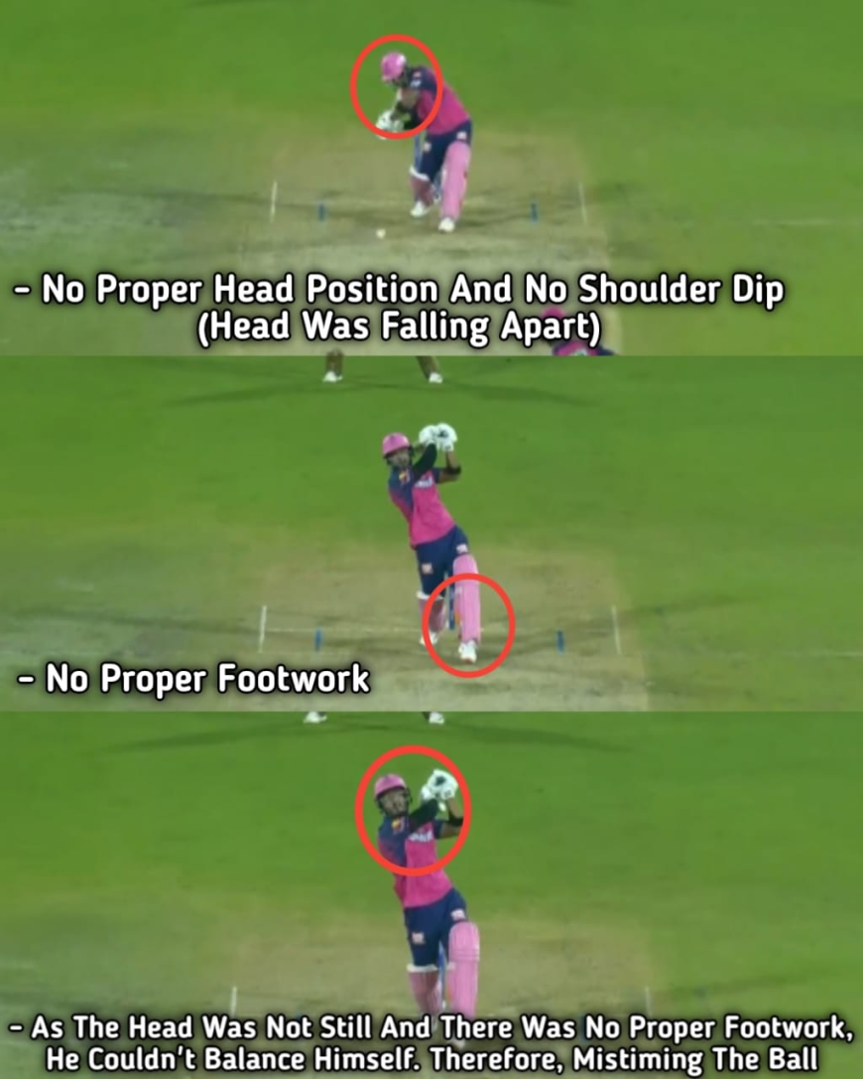
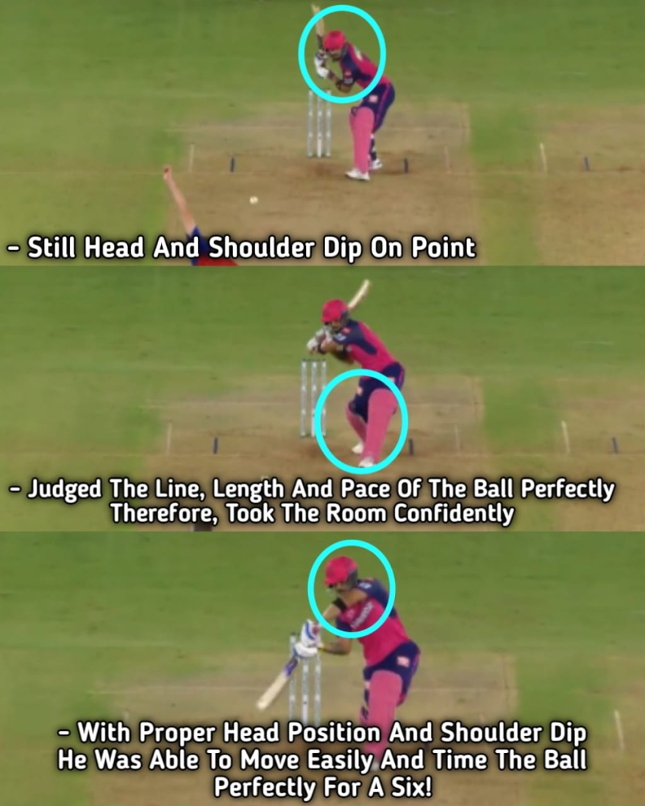
Previous season vs This season Parag vs Full Length Ball on the 4th Stump

Slide 6
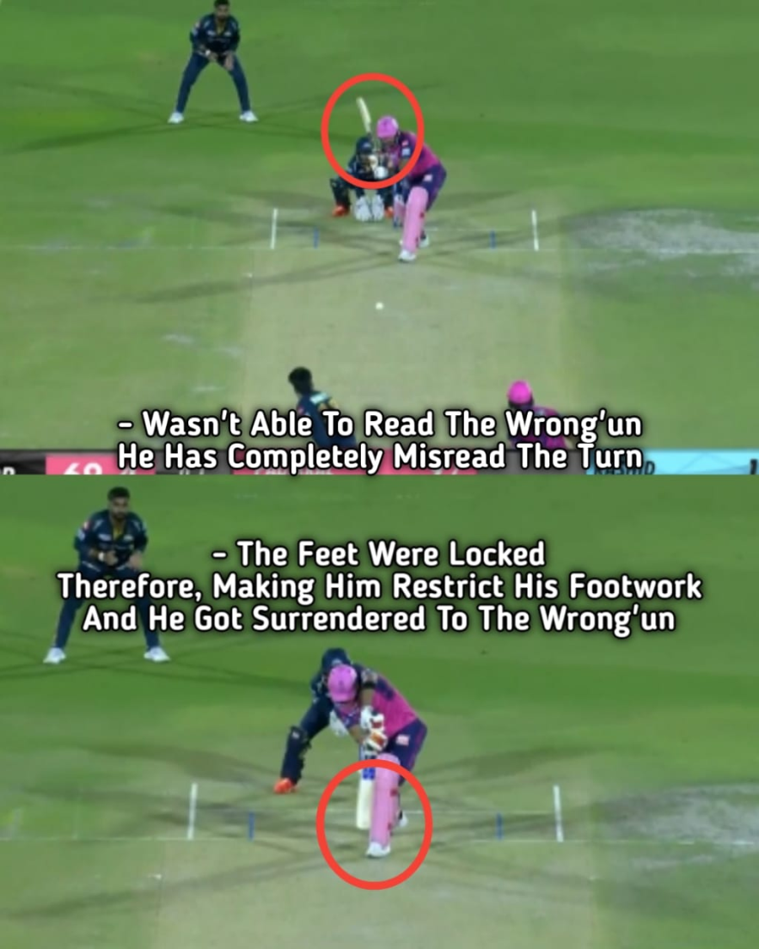
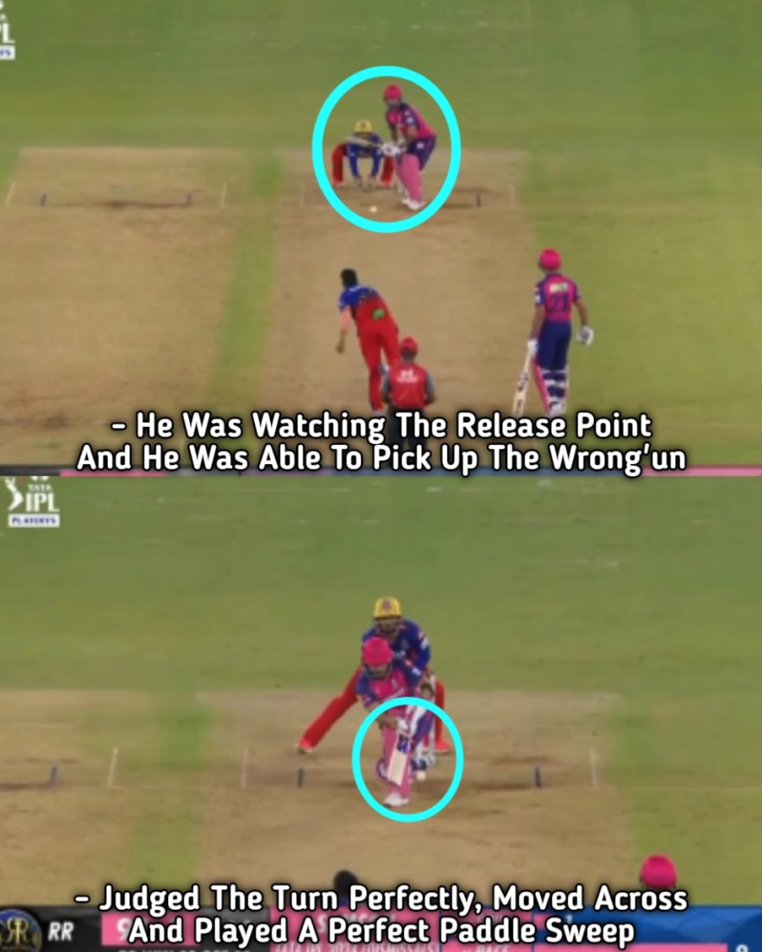
Previous season vs This season Parag vs Wrong’un (Spinner)

Slide 7
Improvement
Parag had a still head position and had a perfectly balanced follow through after hitting the big shots.
He was watching the ball till the end and shifting the body weight when necessary is just top notch.
He changed his mindset a lot, the approach has been just phenomenal. He looks very confident after being promoted up the order and the management backed him.
He has been the most improved player in this season’s IPL with an Avg of 52.1. Hope he continues to do the same in the upcoming years.

Slide 8
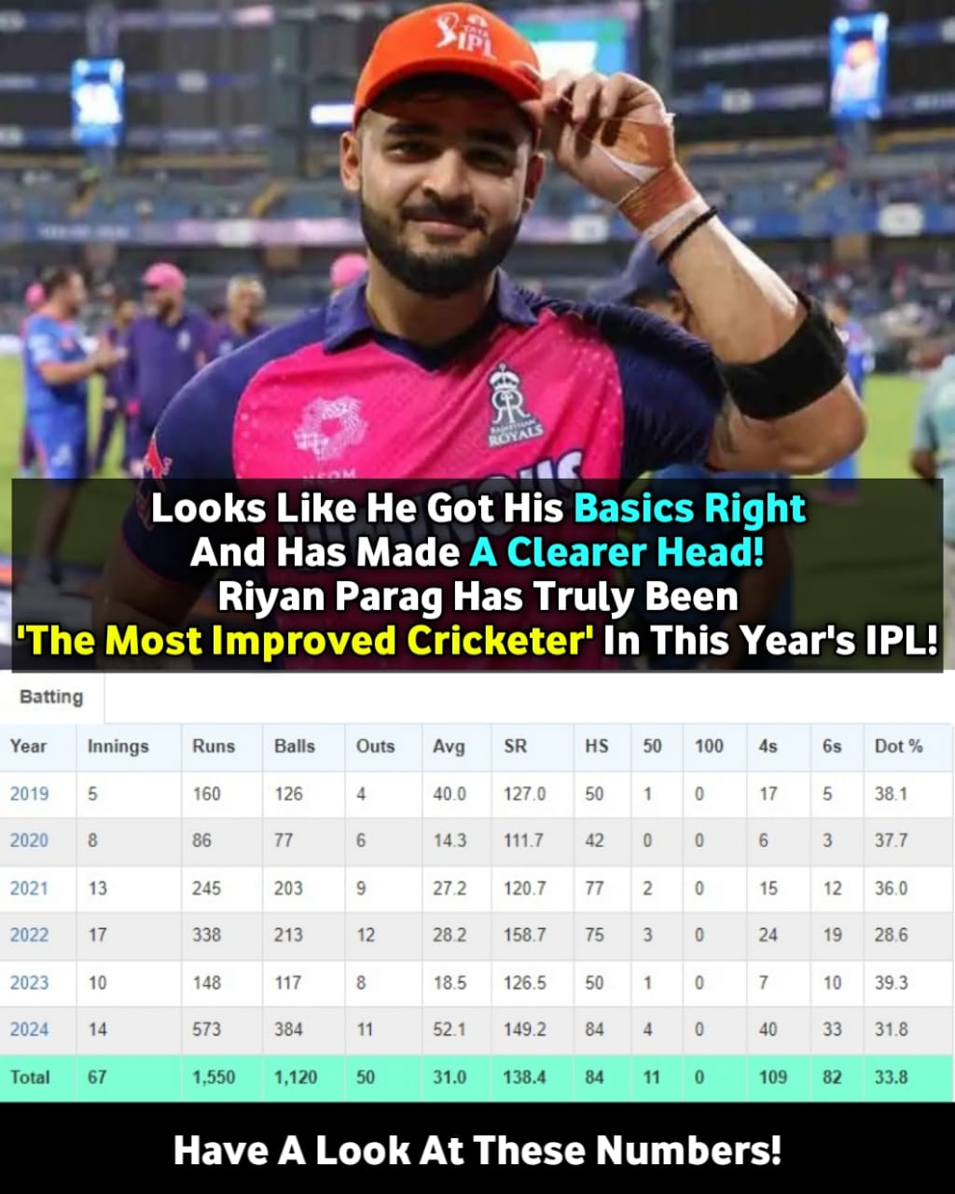
Stats

Slide 9
THANK YOU

